Slide 1
Lesson 6: Network performance and routing costs
Mack 2023
Notes:
Last updated 30-11-2021
Resources are updated regularly — the latest version is available at: ncce.io/tcc.
This resource is licensed under the Open Government Licence, version 3. For more information on this licence, see ncce.io/ogl.

Slide 2
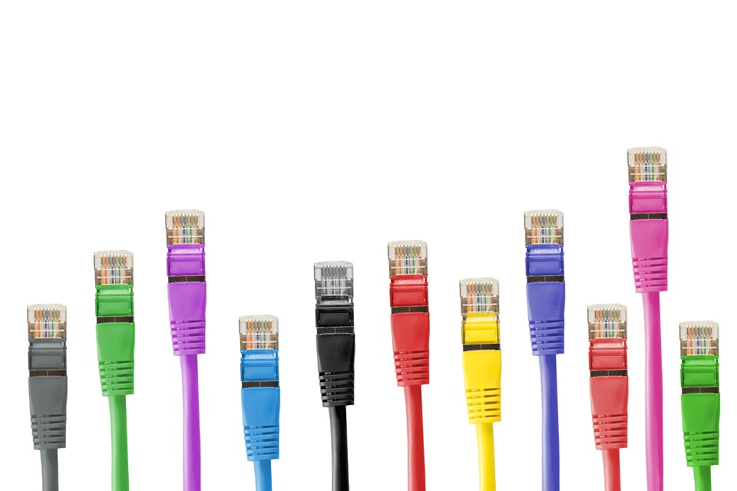
List two types
Starter activity
Question
List two types of wired transmission media.
Explorer task
Which one performs better over long distances?
Notes:
Image source: https://pixabay.com/photos/network-cables-network-connector-494648/

Slide 3
List two types
Starter activity
Two types of wired transmission media are:
Copper cables
Fibre optic cables
Explorer task
Fibre optic cable performs better over long distances.
Notes:
Image source: https://pixabay.com/photos/network-cables-network-connector-494648/

Slide 4

Lesson 6: Network performance and routing costs
Objectives
In this lesson, you will:
Describe the factors that affect network performance (bandwidth, range, latency, number of devices)
Determine how network speeds are measured and construct expressions involving file size, transmission rate, and time
Determine methods of routing traffic on a network and calculate routing costs

Slide 5

Recap
Activity 1
In this unit you have explored:
Types of networks (PAN, LAN, WAN)
The peer-to-peer and client–server models
Network hardware components (hub, switch etc.)
Network topologies (how networks can be arranged)
Transmission media (wired and wireless)

Slide 6
Factors that affect performance
Activity 1
You are now going to take a look at the different factors that affect the speed and reliability of data transfer across a network.
These factors can help with decision making when designing a network.
This is known as the network performance.

Slide 7
Factors that affect performance
Activity 1
The key factors that can affect network performance are:
Bandwidth
Latency
Range
Number of devices

Slide 8
Bandwidth
Activity 1
Bandwidth is a measure of how much data can be transferred in a specific amount of time.
Bandwidth is limited to the type(s) of transmission media that are used across the network.
The higher the bandwidth, the more data the transmission media can transmit at once.

Slide 9
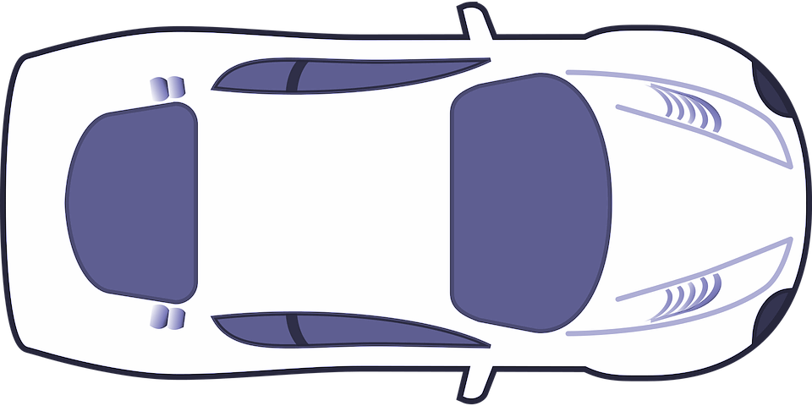
Bandwidth: the motorway example
Activity 1
Think of bandwidth as the number of lanes available on a motorway.
If a motorway has four lanes then four cars can pass through the road network at the same time.
You could say that the ‘bandwidth’ of this motorway is four cars per second.
50
50
50
50
1 sec
Notes:
Car graphic source: https://pixabay.com/vectors/blank-car-game-game-sprite-racing-1299404/

Slide 10

Bandwidth: the motorway example
Activity 1
If three of the lanes close, then this ‘lowers the bandwidth’ of the motorway.
Now, only one car can pass through the network at a time.
The ‘bandwidth’ of the motorway is now just one car per second.
Note that this is an analogy. In reality, the cable doesn’t get thicker when the bandwidth is increased.
50
X
X
X
1 sec
Notes:
Car graphic source: https://pixabay.com/vectors/blank-car-game-game-sprite-racing-1299404/

Slide 11
Bandwidth: uploads and downloads
Activity 1
Bandwidth isn’t just used for downloads, it also includes uploads.
Typically, more bandwidth is given for downloads but this can be changed if required.
↓
↓
↓
↓
Notes:
Car graphic source: https://pixabay.com/vectors/blank-car-game-game-sprite-racing-1299404/

Slide 12
Bandwidth
Activity 1
Bandwidth is typically measured in megabits per second (Mbps) or gigabits per second (Gbps).
Each transmission media type has a maximum bandwidth.

Slide 13
Bandwidth
Activity 1
Here is a list of common transmission media types and their typical bandwidth measurements.
Transmission media | Bandwidth
Copper cable | 10/100 Mbps
Fibre optics | 10 Gbps
Radio signals used with WiFi | 600 Mbps
Radio signals used with Bluetooth | 24 Mbps
Note that these measurements can vary. These are for illustrative purposes only.

Slide 14
Bandwidth
Activity 1
Fibre optics has the highest maximum bandwidth, making it an excellent option for networks with high amounts of traffic.
Transmission media | Bandwidth
Copper cable | 10/100 Mbps
Fibre optics | 10 Gbps
Radio signals used with WiFi | 600 Mbps
Radio signals used with Bluetooth | 24 Mbps

Slide 15
Bandwidth: recap
Activity 1
Bandwidth is a term used to describe the amount of data that can be transferred within a defined time period.
For example,
10 megabits of data per second

Slide 16
Latency
Activity 1
Latency is the delay from the time a signal is sent to when it is received.
Notes:
Animation source: Raspberry Pi Foundation
Laptop image source: https://pixabay.com/vectors/laptop-pc-computer-technology-2243898/

Slide 17
Range
Activity 1
Data travels across a network using signals. These can be light pulses, radio waves, or electrical pulses.
Each type of transmission media has a maximum distance that the signal can travel before the signal quality is lost.
This maximum distance is called the range.
1 0 1 1 1 1 0 0 0 1 1 0 1 0 1

Slide 18
Range
Activity 1
Transmission media | Range
Copper cable | 100 metres
Fibre optics | 40 km
Radio signals used with WiFi | 50 metres
Radio signals used with Bluetooth | 10 metres
The range needs to be considered carefully when deciding which transmission media to use in a network.
Here is a list of transmission media and their maximum range.
Again, you can see that fibre optics comes out on top for its range.

Slide 19

Number of devices
Activity 1
The number of devices connected to a network will affect the network performance.
This is because each device will take a share of the bandwidth available and the network traffic.
You might have noticed this if you have ever tried to use free internet or mobile data in a crowded area, like at a concert.
Notes:
Image source: https://pixabay.com/photos/smartphone-hands-screen-407108/

Slide 20
Number of devices
Activity 1
With each new device that tries to access the free internet connection, the data transfer rate reduces.
Eventually, there are so many devices trying to share the same network that it becomes almost impossible to download or upload any data.
Notes:
Image source: https://pixabay.com/photos/smartphone-hands-screen-407108/

Slide 21
Number of devices
Activity 1
When creating a new network, it is important to consider the maximum number of devices that will use the network.
It is also a good idea to future proof the network in case more devices are added later on.
Notes:
Image source: https://pixabay.com/photos/smartphone-hands-screen-407108/

Slide 22
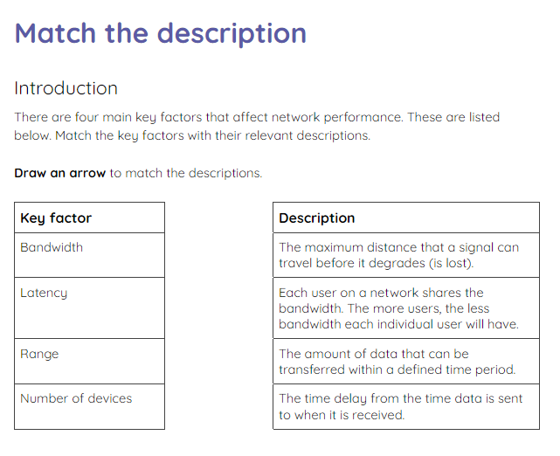
Match the descriptions
Activity 1
Use the activity 1 sheet to match the key factors to their descriptions.

Slide 23
Match the descriptions: solutions
Activity 1
Key factor |  | Description
Bandwidth |  | The maximum distance that a signal can travel before it degrades (is lost).
Latency |  | Each user on a network shares the bandwidth. The more users, the less bandwidth each individual user will have.
Range |  | The amount of data that can be transferred within a defined time period.
Number of devices |  | The time delay from the time data is sent to when it is received.

Slide 24
Match the descriptions: solutions
Activity 1
Key factor |  | Description
Bandwidth |  | The maximum distance that a signal can travel before it degrades (is lost).
Latency |  | Each user on a network shares the bandwidth. The more users, the less bandwidth each individual user will have.
Range |  | The amount of data that can be transferred within a defined time period.
Number of devices |  | The time delay from the time data is sent to when it is received.

Slide 25
Match the descriptions: solutions
Activity 1
Key factor |  | Description
Bandwidth |  | The maximum distance that a signal can travel before it degrades (is lost).
Latency |  | Each user on a network shares the bandwidth. The more users, the less bandwidth each individual user will have.
Range |  | The amount of data that can be transferred within a defined time period.
Number of devices |  | The time delay from the time data is sent to when it is received.

Slide 26
Match the descriptions: solutions
Activity 1
Key factor |  | Description
Bandwidth |  | The maximum distance that a signal can travel before it degrades (is lost).
Latency |  | Each user on a network shares the bandwidth. The more users, the less bandwidth each individual user will have.
Range |  | The amount of data that can be transferred within a defined time period.
Number of devices |  | The time delay from the time data is sent to when it is received.

Slide 27
Match the descriptions: solutions
Activity 1
Key factor |  | Description
Bandwidth |  | The maximum distance that a signal can travel before it degrades (is lost).
Latency |  | Each user on a network shares the bandwidth. The more users, the less bandwidth each individual user will have.
Range |  | The amount of data that can be transferred within a defined time period.
Number of devices |  | The time delay from the time data is sent to when it is received.

Slide 28
Calculating file transfer time
Activity 2
It is possible to calculate how long a file will take to transmit from one location to another on a network.
If you know the size of the file (in bits) and the speed of the network (in bits per second), then you can calculate the time it takes.

Slide 29

Calculating file transfer time
Activity 2
This is the formula that you can use:
time = size of file (in bits) ÷ network speed (in bits)

Slide 30
Calculating file transfer time
Activity 2
This is the formula that you can use:
time = size of file (in bits) ÷ network speed (in bits)
If the size of the file is 100 bits and the network speed is 2 bits per second then the formula is:
time = 100 ÷ 2

Slide 31
Calculating file transfer time
Activity 2
This is the formula that you can use:
time = size of file (in bits) ÷ network speed (in bits)
If the size of the file is 100 bits and the network speed is 2 bits per second then the formula is:
time = 100 ÷ 2
time = 50 seconds

Slide 32
Calculating file transfer time
Activity 2
50 seconds to transmit 100 bits of data is very slow with today’s technology.
Most speeds are measured in megabits or gigabits and file sizes can be extremely large.

Slide 33
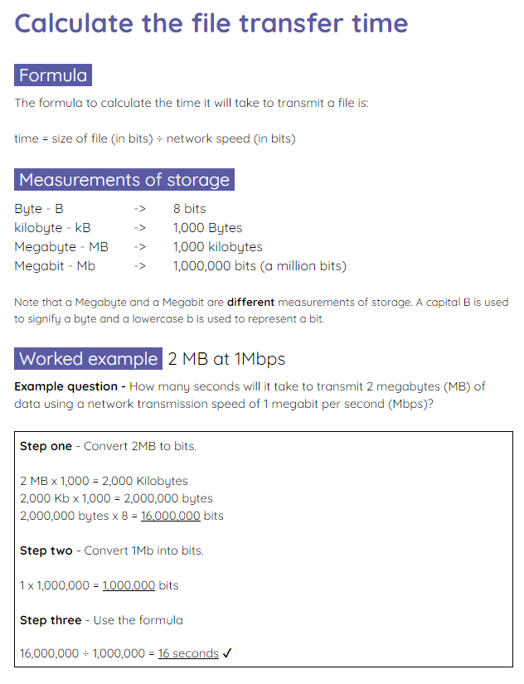
Calculate the file transfer time
Activity 2
Use the activity 2 sheet to calculate the file transfer times based on the scenarios given.
You will need to convert the measurements of storage to calculate your answers. Use the example on the first page to support you with this.

Slide 34
Routing traffic on a network
Activity 3
Networks can have many nodes and connection types.
Nodes can be made up of different device types like routers or switches.
Connections can be made up of varying transmission media like wireless connections and fibre optic cables.

Slide 35
Routing traffic on a network
Activity 3
A network’s main function is to provide the infrastructure for sharing data and resources with other devices on that network.
In order to be able to share data, it needs to know where it should transmit the data to and which route to take.

Slide 36
Routing traffic on a network
Activity 3
In order for the network to determine the best route for transmitting data, it uses routing protocols.
Routing protocols are rules used to calculate the best routes for routing traffic.

Slide 37
Routing traffic on a network
Activity 3
Measures are used to calculate the ‘cost’ of each link in the network.
Cost refers to the time taken, the bandwidth available, and several other factors across each link.
5
7
3
9
3
5
5
6
2

Slide 38
Routing traffic on a network
Activity 3
In order to select the best route, an algorithm will use these link costs to calculate the lowest cost route, by adding together each of the link costs of the route.
✉
5
7
3
9
3
5
5
6
2

Slide 39
Routing traffic on a network
Activity 3
Route one
5 + 5 = 10
✉
5
7
3
9
3
5
5
6
2

Slide 40
Routing traffic on a network
Activity 3
Route one
5 + 5 = 10
Route two
5 + 3 + 6 = 14
✉
5
7
3
9
3
5
5
6
2

Slide 41
Routing traffic on a network
Activity 3
Route one
5 + 5 = 10
Route two
5 + 3 + 6 = 14
Route three
3 + 6 = 9
✉
5
7
3
9
3
5
5
6
2

Slide 42
Routing traffic on a network
Activity 3
Route one
5 + 5 = 10
Route two
5 + 3 + 6 = 14
Route three
3 + 6 = 9
✉
5
7
3
9
3
5
5
6
2
✔

Slide 43
Routing traffic on a network
Activity 3
Route three has the lowest cost so this route is used to transmit the data.
✉
5
7
3
9
3
5
5
6
2
✉
✔

Slide 44
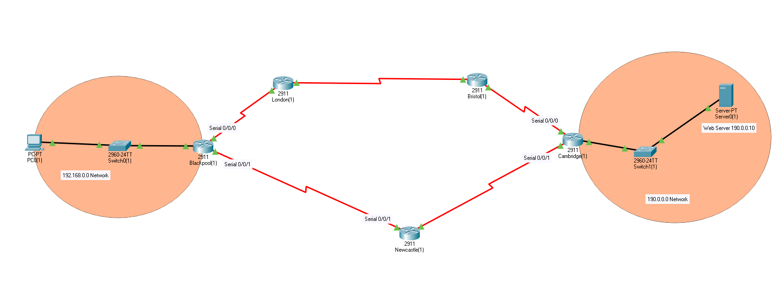
Investigating routes
Activity 3
You can investigate routes and routing costs using Packet Tracer.

Slide 45
Investigating routes
Activity 3
This is a simulation of a home network.
Home network

Slide 46
Investigating routes
Activity 3
The home network can access a website on a server in Cambridge.
Home network
Network in Cambridge

Slide 47
Investigating routes
Activity 3
The network traffic can take one of two routes.
Route one
Route two
Home network
Network in Cambridge

Slide 48
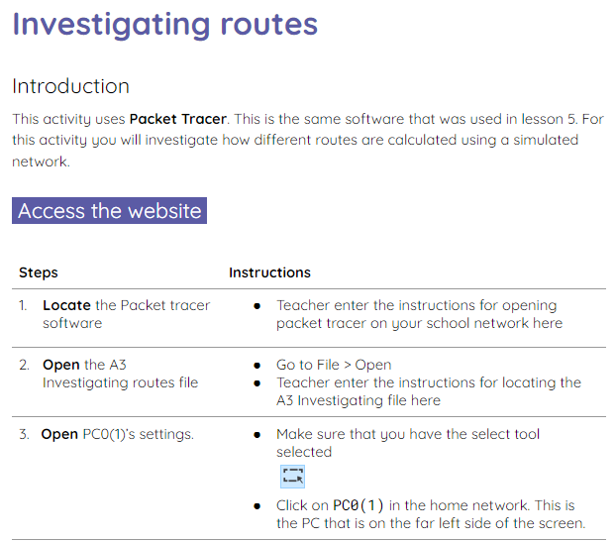

Investigating routes
Activity 3
Use the activity 3 sheet to learn how to use Packet Tracer to investigate routing costs.
Video walkthroughs are available if needed.

Slide 49
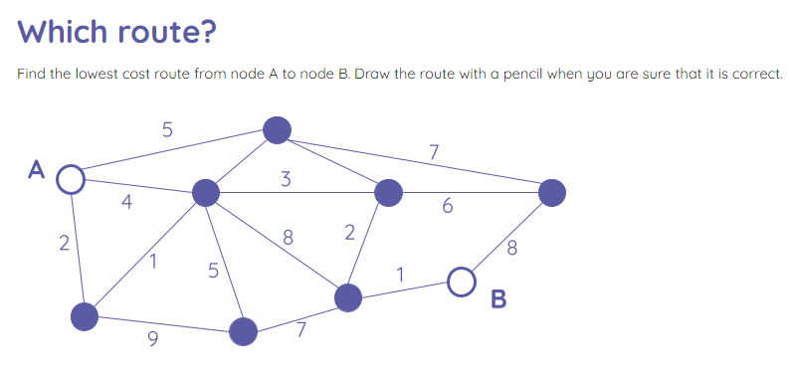
Which route?
Wrap Up
Use the activity sheet to decide which route the data should take to get from node A to node B.
You must calculate the lowest cost route.

Slide 50
Which route? Solution
Wrap Up
5
4
7
A
5
3
4
6
2
2
8
8
1
5
1
B
9
7
Cost: 9

Slide 51
Next lesson
Summary
In this lesson, you…
Learnt about the factors that affect network performance
Calculated how much time it would take to transmit files across a network
Discovered how data is routed
Next lesson, you will…
Learn how the internet works.

